Slide 1

IT RELATED CHANGE MANAGEMENT TO ENHANCEBUSINESS PERFORMANCE WITH SPECIAL REFERENCE TO MARKSS HLC

Slide 2
Group
U.G. Navodi N. Kariyawasam – 12255997
H. M. Gaveshika Gunaratne – 12256112
K. K. A. D. T. K Kumarasinghe – 12256016
S. G. Chathuska Silva - 12256159
D. Sasikala N. Weerasuriya - 12255951

Slide 3
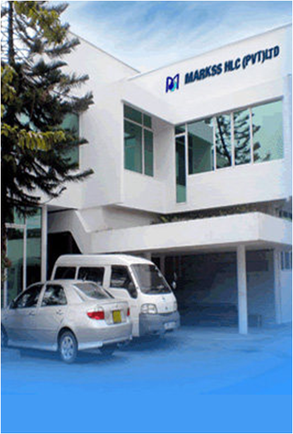
Company background
Dynamic Health Care Company
Provides the highest quality healthcare products.
Hold its association and membership with
National Stroke Association of Sri Lanka
National Chamber of Commerce of Sri Lanka

Slide 4
Introduction to the study
Markss HLC has implemented three Information Systems
Purchase order system
Inventory control system
HRIS

Slide 5
Reasons for failure of IT related change
Lack of employee engagement and motivation
Managing change only at the management level
Lack of analysis on the risk factors
Lack of integration of corporate strategy and IT strategy
Lack of user friendly system implementation
Lack of user feedback
Lack of resource allocation

Slide 6
Objectives
Identify effective change management strategies in automation
Indentify influences by organization culture on employee behavior in change implementation
Identify effective means in implementing IS in an organization to align with corporate strategy

Slide 7
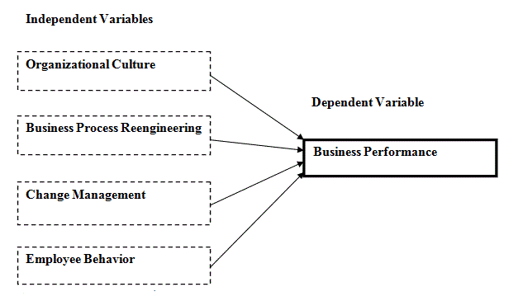
Literature Review

Slide 8
Research Methodology
Study Sample
Markss HLC
Purchasing Department
Inventory Control Department
HR Department
6
6
6

Slide 9
Data collection methods
Interviews
Questionnaires
Limitations
Confidentiality of information by the company
Technological limitations
Logistical limitations

Slide 10
Research Findings

Slide 11
Business Performance

Slide 12
Results of Interviews Conducted with the top management

Slide 13
User Perception

Slide 14
User characteristics

Slide 20
Recommendation
Improve employee involvement in decision making
Stimulate employee awareness regarding the change
Provide training on using IT to perform work related tasks effectively and efficiently.
Conduct onsite or off site programs to improve English proficiency
Maintain user manuals to the systems
Establish a separate IT department
Provide training on the system
Increase user involvement in planning the systems
Implement an ERP solution (Enterprise Resource Planning) to enhance integration

Slide 21
